Slide 1



Natural Language Processing (NLP) Project
G3 Presentation
Participants: Alex Castillo, Latif Calderon & Larry W. Davila

Slide 2
Project Management:
Larry: Data exploration and preprocessing.
Alex: Model development and optimization.
Latif: Implementation and documentation.
Team: Review and presentation preparation.
Welcome

Slide 3
Data Evaluation and Processing
TRAINING_DATA.txt data verification
Data split into train and test.
Data Cleaning:
Text converted into lower case.
Removal special characters, extra spaces, accents, and numbers. Note: The cleaning process applied maintains the “ñ” character because it impacts the context in Spanish language.
Spanish Stopwords removal.
Vectorization applied using TfidfVectorizer
Welcome

Slide 4
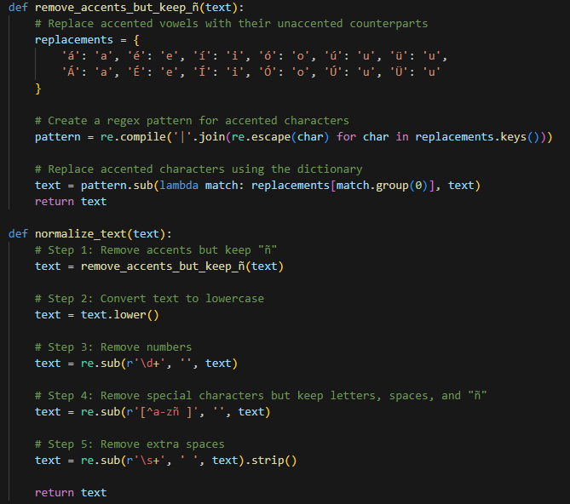
Data Evaluation
and Processing
Welcome

Slide 5
Models Tested and results obtained
Model Name | Train Accuracy | Test Accuracy
Support Vector Classifier (SVC) | 76% | 40%
Multinomial Naive Bayes | 79% | 35%
Logistic Regression | 75% | 42%
XGBoost Classifier | 60% | 50%
Random Forrest | 99% | 32%
Welcome

Slide 6
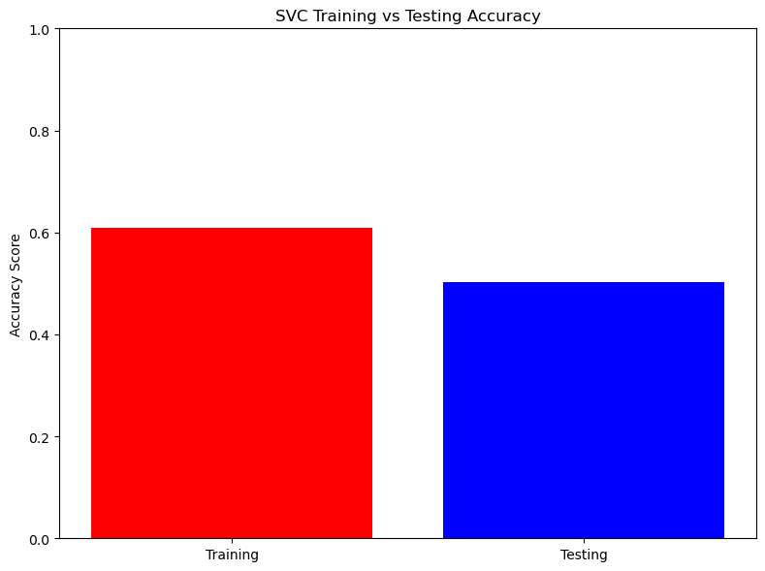
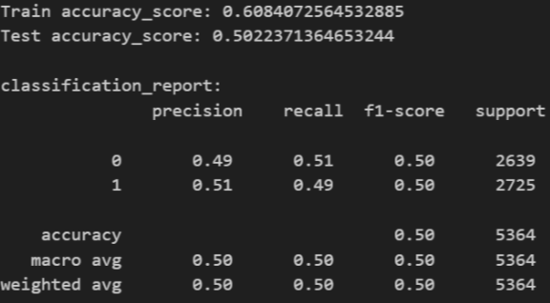
Selected Model
XGBoost Classifier model = xgb.XGBClassifier(learning_rate=0.1,
max_depth=3,
n_estimators=100,
min_child_weight=1,
gamma=0,
subsample=0.8,
colsample_bytree=0.8,
objective='binary:logistic’,
nthread=4,
scale_pos_weight=1,
seed=27)
Welcome

Slide 7
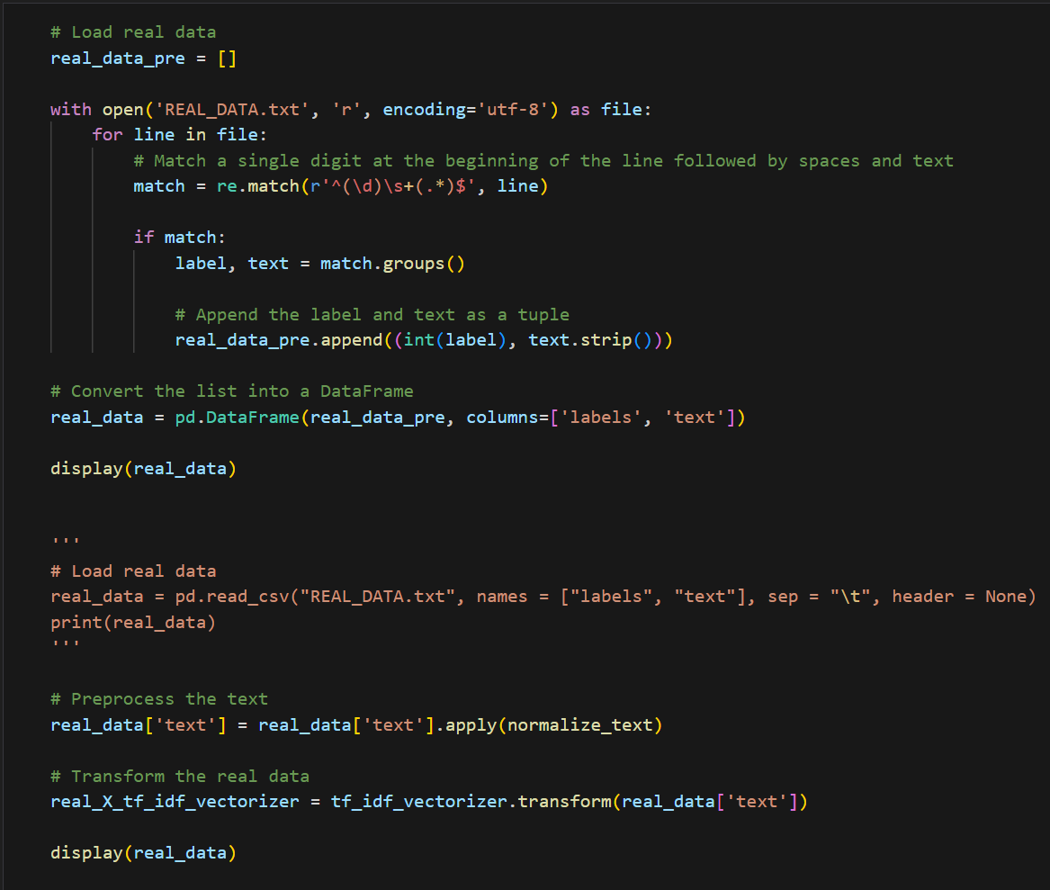
Real Data Treatment and Predictions Process
Steps:
Reading REAL_DATA.txt
Data Cleaning.
Predictions.
Append predictions into new file “G3_labeled_data.txt”
Welcome

Slide 8
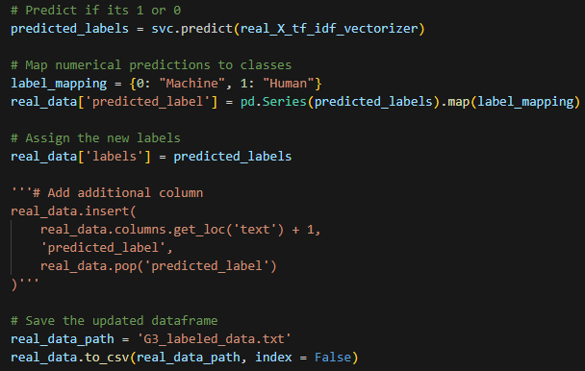
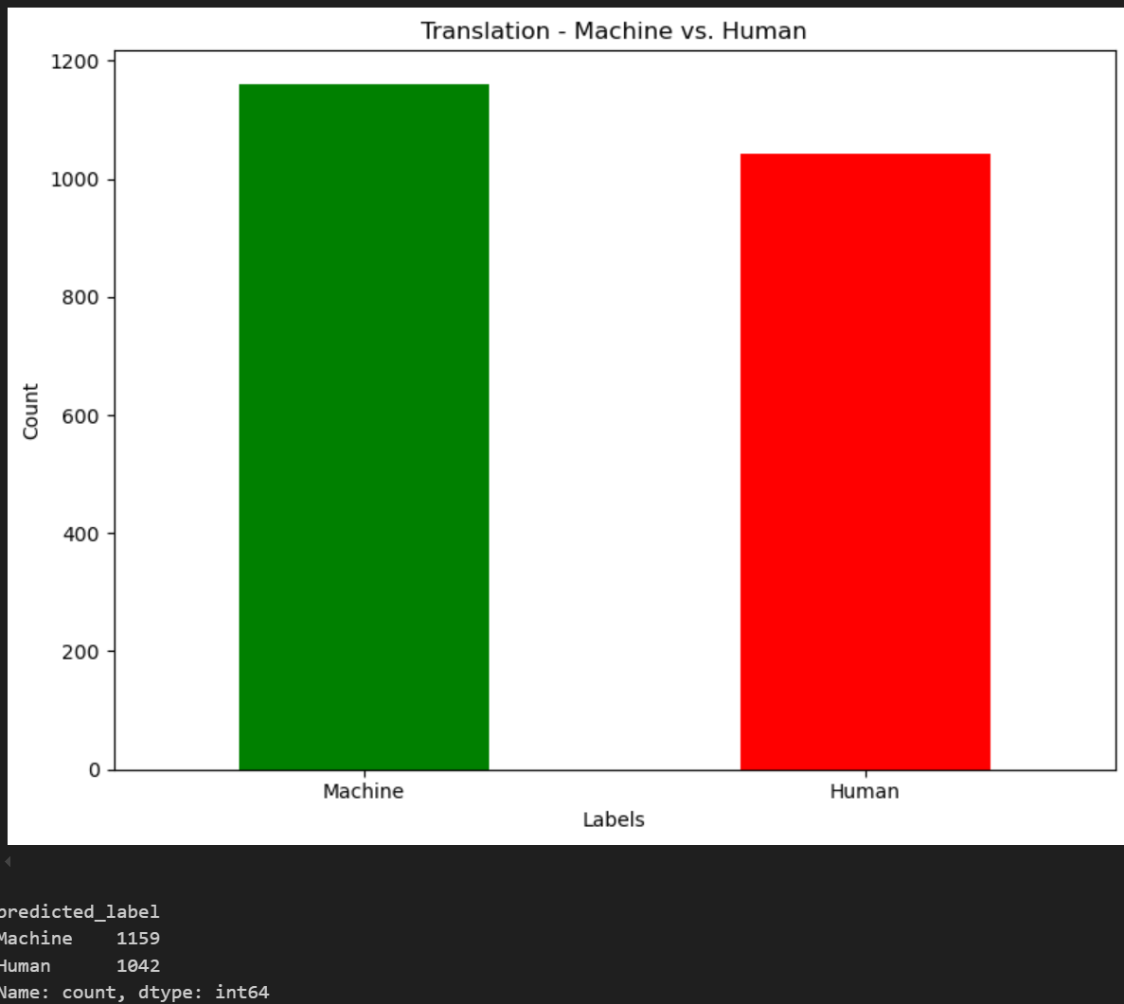
Real Data Treatment and Predictions Process
Welcome

Slide 9
Major Challenges
Reading TRAINING_DATA.txt and REAL_DATA.txt
Data cleaning process.
Model Training process.
Welcome

Slide 10
Thanks!!!
Happy Coding!

